Slide 1

ONLINE AUCTION
By : TechAmigas

Slide 2
OUR TEAM
Manya Bhardwaj
Swanand Khonde
Harshika Golkonda
Ayushi Lonkar
Srividya Ghanta
Shardul Sandeep Khandekar
Abdul Mueed Dalvi
Bhakti Jain
Prasanna Laxmi Meesala
Narayani Verma

Slide 3

INTRODUCTION
Online Auction System is a web based application which helps a user to buy and sell the items.
It allows sellers to set their products for auction and buyers to bid for various products which are available for auctioning.
It eliminates the disadvantages of the conventional system where users have to sit and bid.

Slide 4
SOFTWARE REQUIREMENTS
HTML
CSS
JAVASCRIPT
JAVA
MYSQL

Slide 5




DEVELOPER TOOLS
GitHub
MySQL Database
Spring tool Suite
Bootstrap
Framework

Slide 6
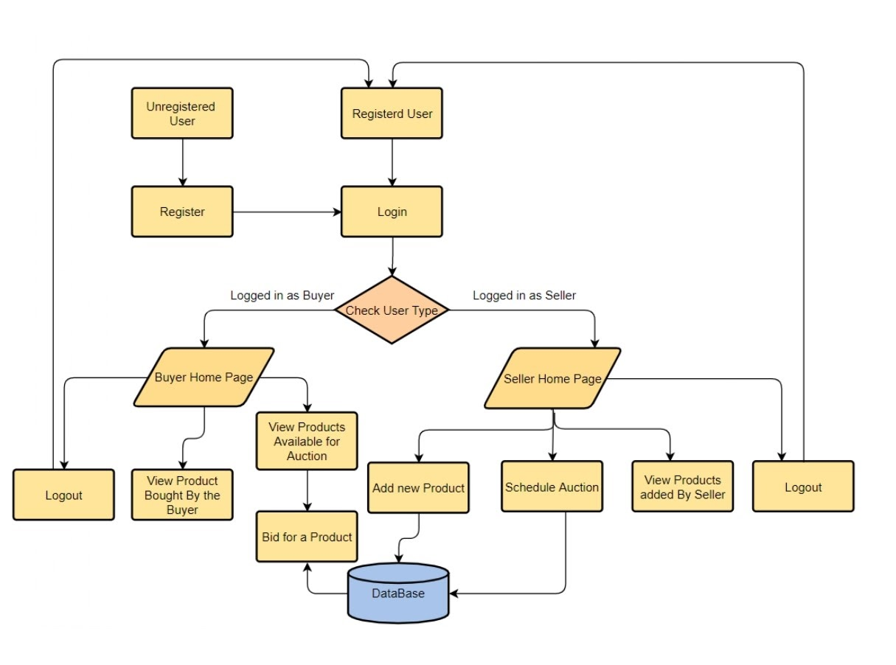
Data Flow Diagram

Slide 7
WORK FLOW
Register :
System will allow users to create account
Login :
System will allow the user to login.
System will verify the user name and password.
System will not allow user to login with invalid username or password.
Browsing and database search :
System will allow user to search products that are available for auction.
System shall display the result.
System will allow the bidder to bid on desired product

Slide 8
WORK FLOW
Auction :
System will allow users to post for product they want to sell.
System will allow users view their active bids (that are in progress).
Purchase History :
System will allow the user to view their purchase history

Slide 9
FEATURES & FUNCTIONALITIES
BUYER :
Features:
List of products bought by the buyer in the auction.
List of products currently available for the auction.
Button to bid for a product.
Features:
Buyer can place a bid for a product by clicking on the auction button
Buyers can place the bid amount

Slide 10
FEATURES & FUNCTIONALITIES
SELLER :
Features:
List of products auctioned by the seller.
Button to add new product to be auctioned.
List of auctioned products that are sold.
Functionalities :
Seller can add new product for auctioning.
Seller can schedule an auction.

Slide 11
LEARNINGS
Team Work
Self Learning
Working under strict deadlines
Asking for help whenever required
Effective communication plays a vital role in team projects
Interacting with people from different backgrounds and learning from each other.
Considering every member’s opinion and point of view before taking major steps.

Slide 12
Thank You

